Slide 2
Hybrid multi-cloud Infrastructure as Code using Terraform
BRK 3043
Mark Gray
Sr. Program Manager
Microsoft

Slide 3
Session objectives and takeaways
At the end of this session, you should be
better able to …
Understand how Azure fits into your multi-cloud strategy
Be confident that Microsoft is investing deeply in Terraform
Become part of the community making Terraform in Azure better
Key takeaway from this session …
Have the tools / tips needed to take full advantage of Terraform in Azure

Slide 5
©2017 RightScale, Inc. All rights reserved. This work by RightScale is licensed under a Creative Commons Attribution 4.0 International License

Slide 8
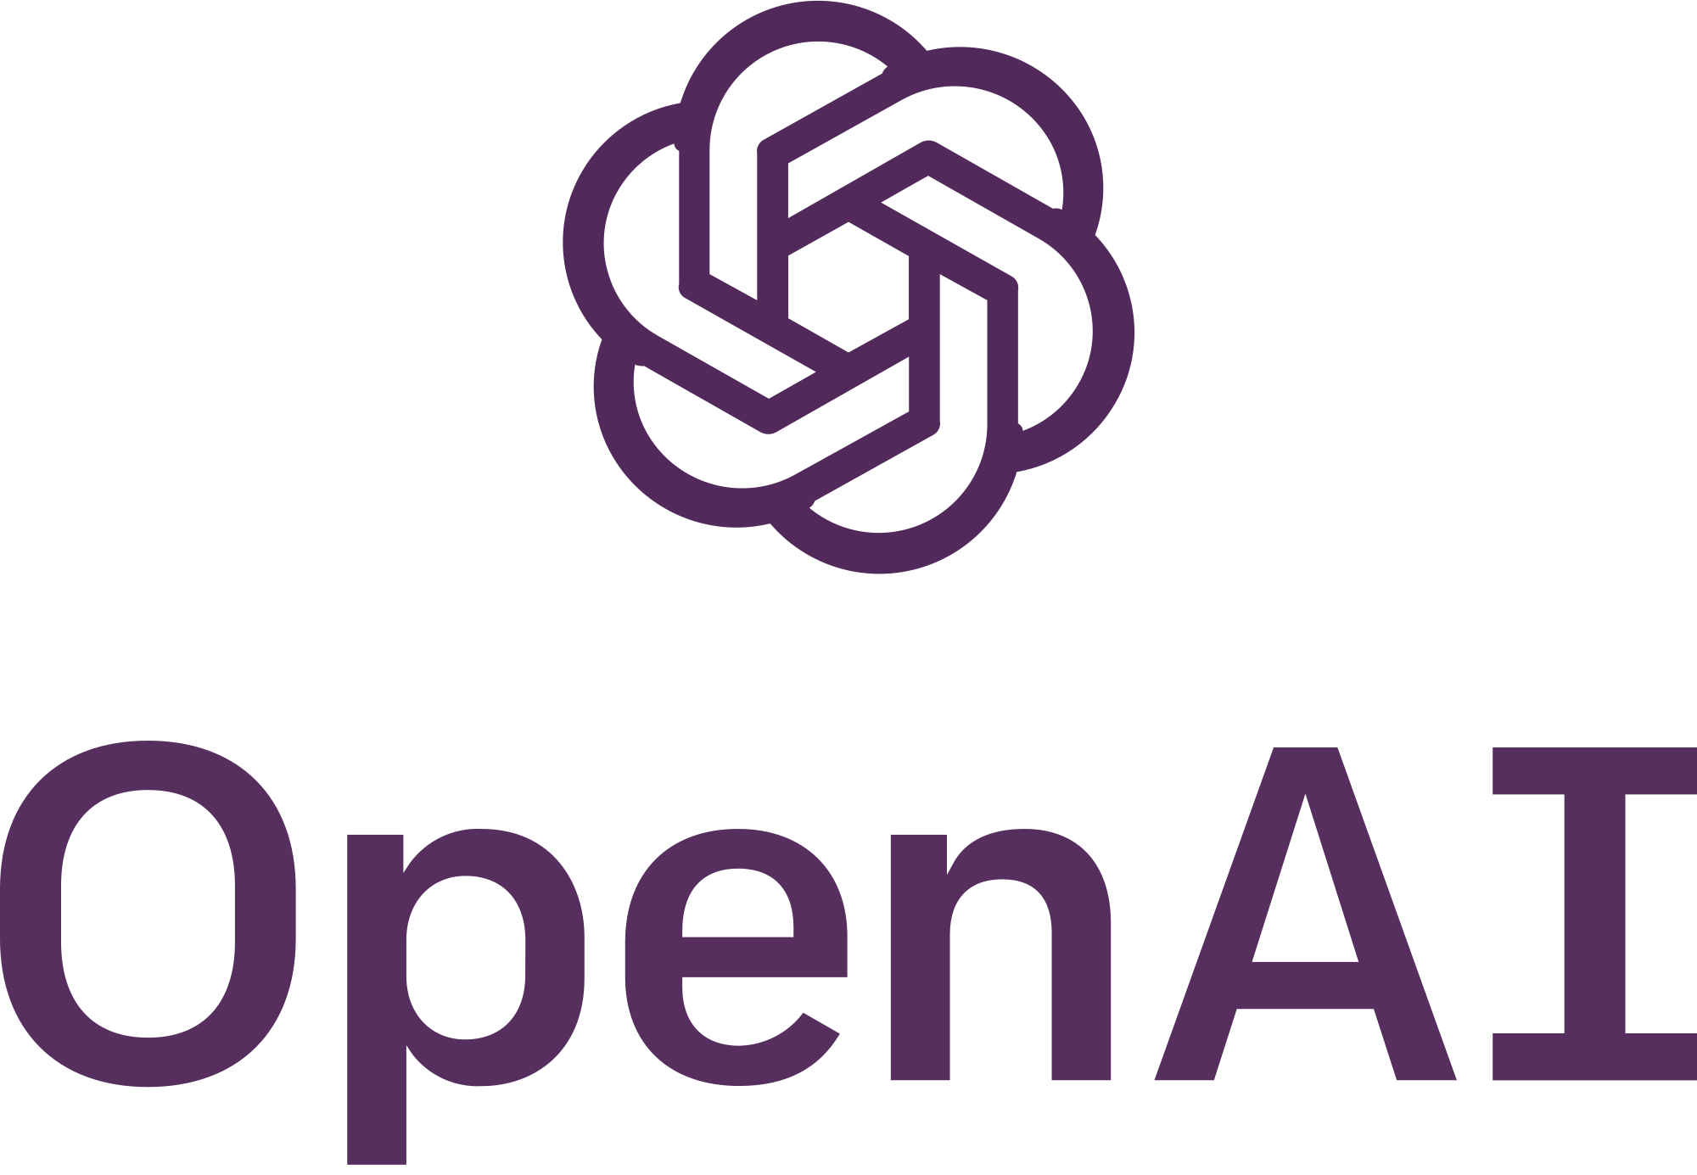
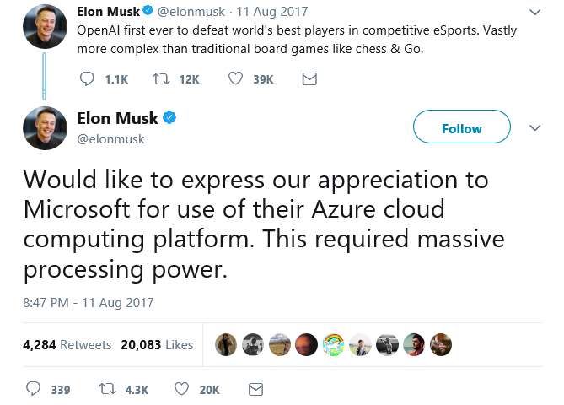
CC0

Slide 9
Open Source
According to Forrester, over forty percent of CIOs view adoption of open source technologies as critical for them in the next year – primarily because of low cost, avoidance of vendor lock-in and agility.
And that same North Bridge study saw use of OSS increased sixty-five percent over same companies surveyed from previous year.
Mark Russinovich on Microsoft Blog

Slide 10
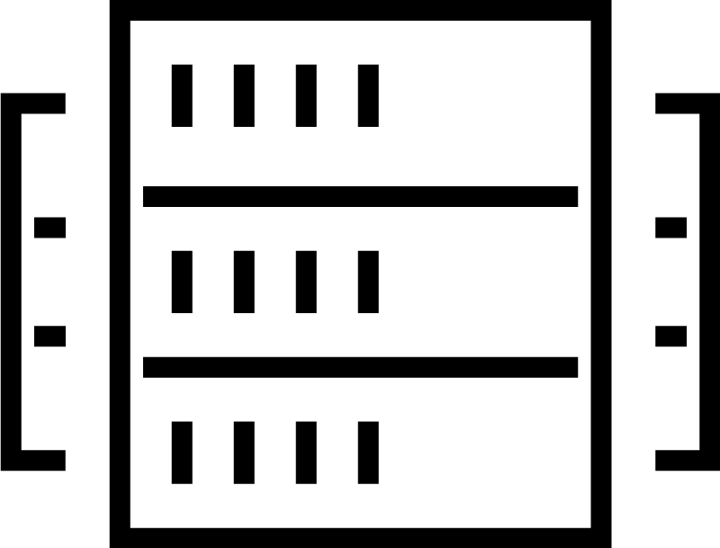





Multi-cloud infrastructure transition
TRADITIONAL DATACENTER
HYBRID DATACENTER
Application Platform
Security
Private cloud
AWS
Azure
GCP
Core Infrastructure
(Reproduced with permission from Hashicorp)
Notes:
In spite of what Docker will have you believe, containers and kubernetes haven’t homogenized the infra layer.
Customers want the best of all clouds private public or 3rd party. They don't want the JVM (lowest common denominator), but the Android (Open but can use best of each phone's hardware) approach.
So why should you care?
Heterogeneity - The challenge for customers moving to cloud is to enable automation through infrastructure as code while embracing the inevitable heterogeneity of different cloud providers that their polyglot app developers demand.
In traditional data center infra is essentially finite homogenous. Ops provision things across this finite pool upon which apps are deployed.
In Cloud, infra is essentially infinite and heterogenous. Each cloud provider provides a unique inventory of available infrastructure services. This heterogeneity is what gives each cloud its richness but also introduces tremendous complexity for developers who must learn the idiosyncrasies of provisioning each infrastructure type.
Talk about the diagram.

Slide 11

Terraform logo reproduced with permission from Hashicorp

Slide 12

Terraform logo reproduced with permission from Hashicorp

Slide 13
Infrastructure as Code
Reproducible Environments
Automation – CI/ CD
Trackable – GitHub
Language - HCL
Workflow
Providers
Apply same config across clouds

Slide 14
Providers
Defines how Terraform will interact with:
Cloud
Azure
AWS
Google
AliCloud
OpenStack
Infrastructure
Kubernetes
Docker
Rancher
Network
DNS
Cloudflare
HTTP
Version Control
GitHub
GitLab
Bitbucket
Monitoring
DataDog
Grafana
PagerDuty
Database
InfluxDB
MySQL
PostgreSQL
Etc.

Slide 15
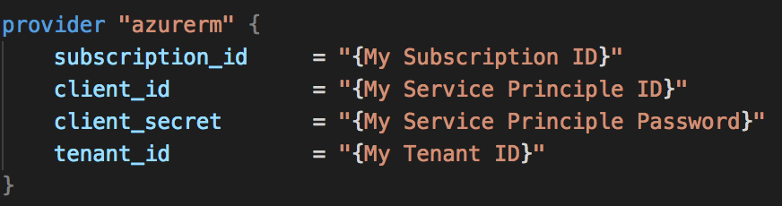
Azure Provider
Authentication
Azure CLI
Service Principal
MSI
Arguments
Environment Variables

Slide 16

Resources & Data Sources
This Photo by Unknown Author is licensed under CC BY-SA-NC

Slide 17
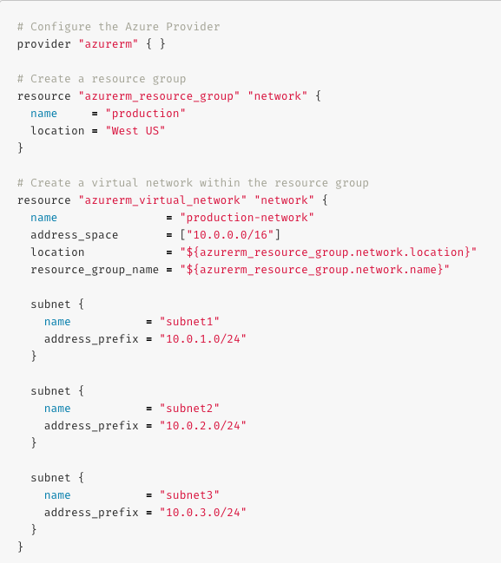
Azure Resources & Datasources
Provisioning for Azure IaaS
Compute (VMSS, Disk, Image, Snapshot, …)
Networking (Vnet, LB, DNS, …)
Azure Active Directory
Database (MySQL, PostgreSQL, SQL)
Monitoring
Storage (Storage Account, Blob, Share, …)
…
Provisioning for Azure PaaS
Containers (AKS, ACI)
Web Apps
CosmosDB
Data Lake
Logic Apps
KeyVault
…
Catch-All
ARM Template

Slide 18
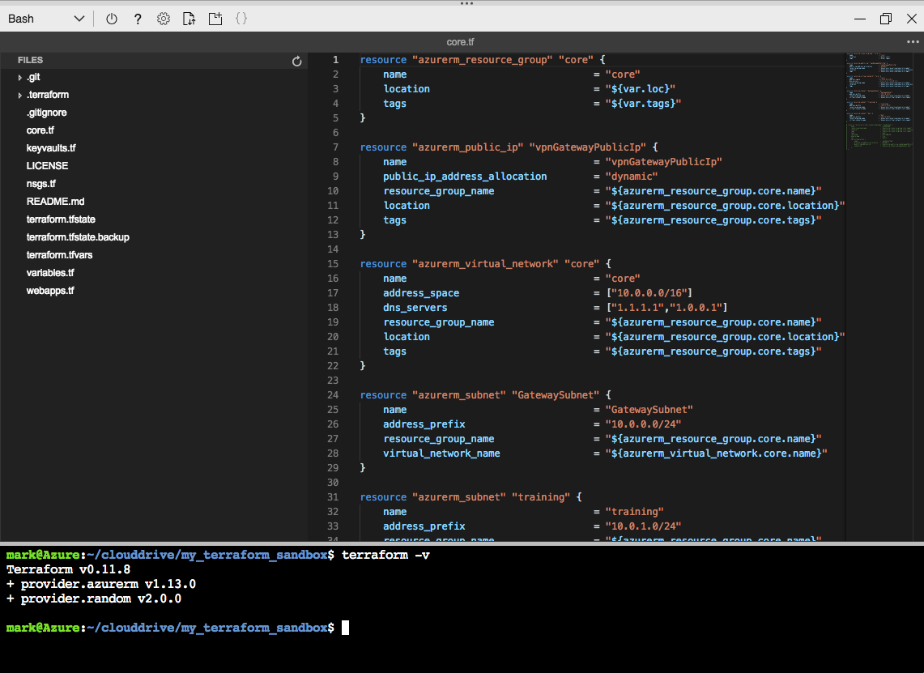
Assembly
Cloud Shell
Terraform integration
Editor with Terraform Syntax Highlighting
Visual Studio Code
Terraform extension
Azure Terraform extension

Slide 19
Workflow
Init
Plan
Apply
Destroy

Slide 20
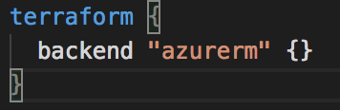
Azurerm backend
Standard Backend with state locking & consistency checking
Azure Storage (Blob)
remote-state.tf .backend.tfvars

Slide 21
Demo 3 State

Slide 22

Abstraction Modules

Slide 23
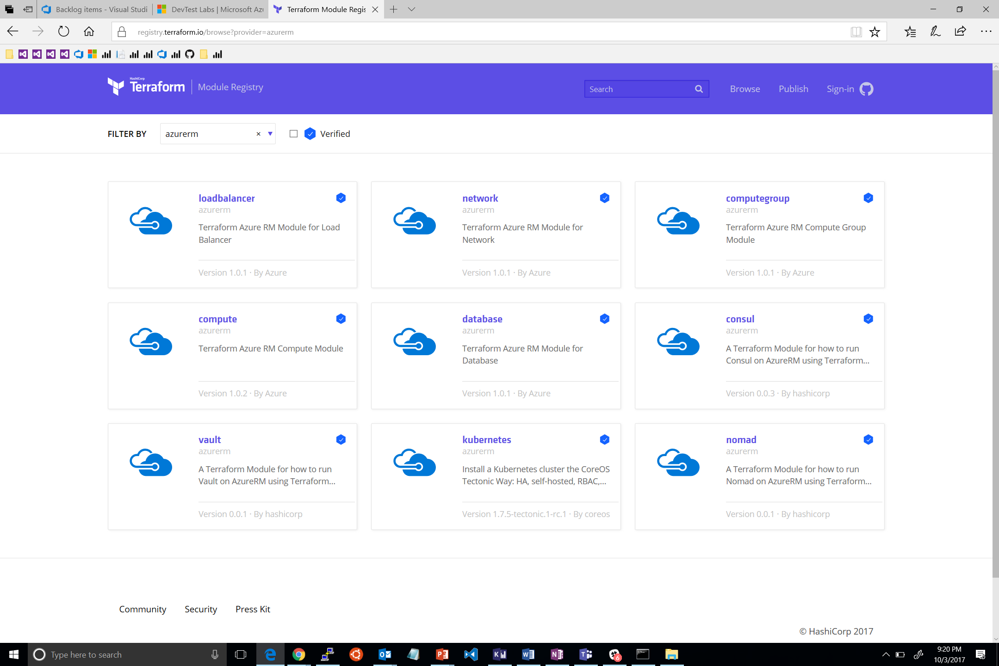

Slide 24
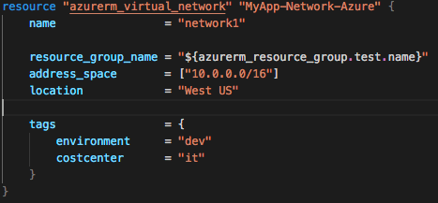
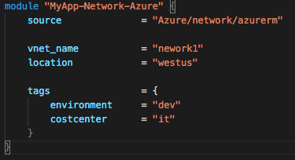
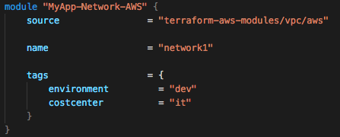
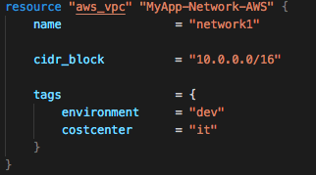
Modules

Slide 25
Demo 4 Modules

Slide 26

Community CC BY-SA 3.0 Nick Youngson / Alpha Stock Images

Slide 27

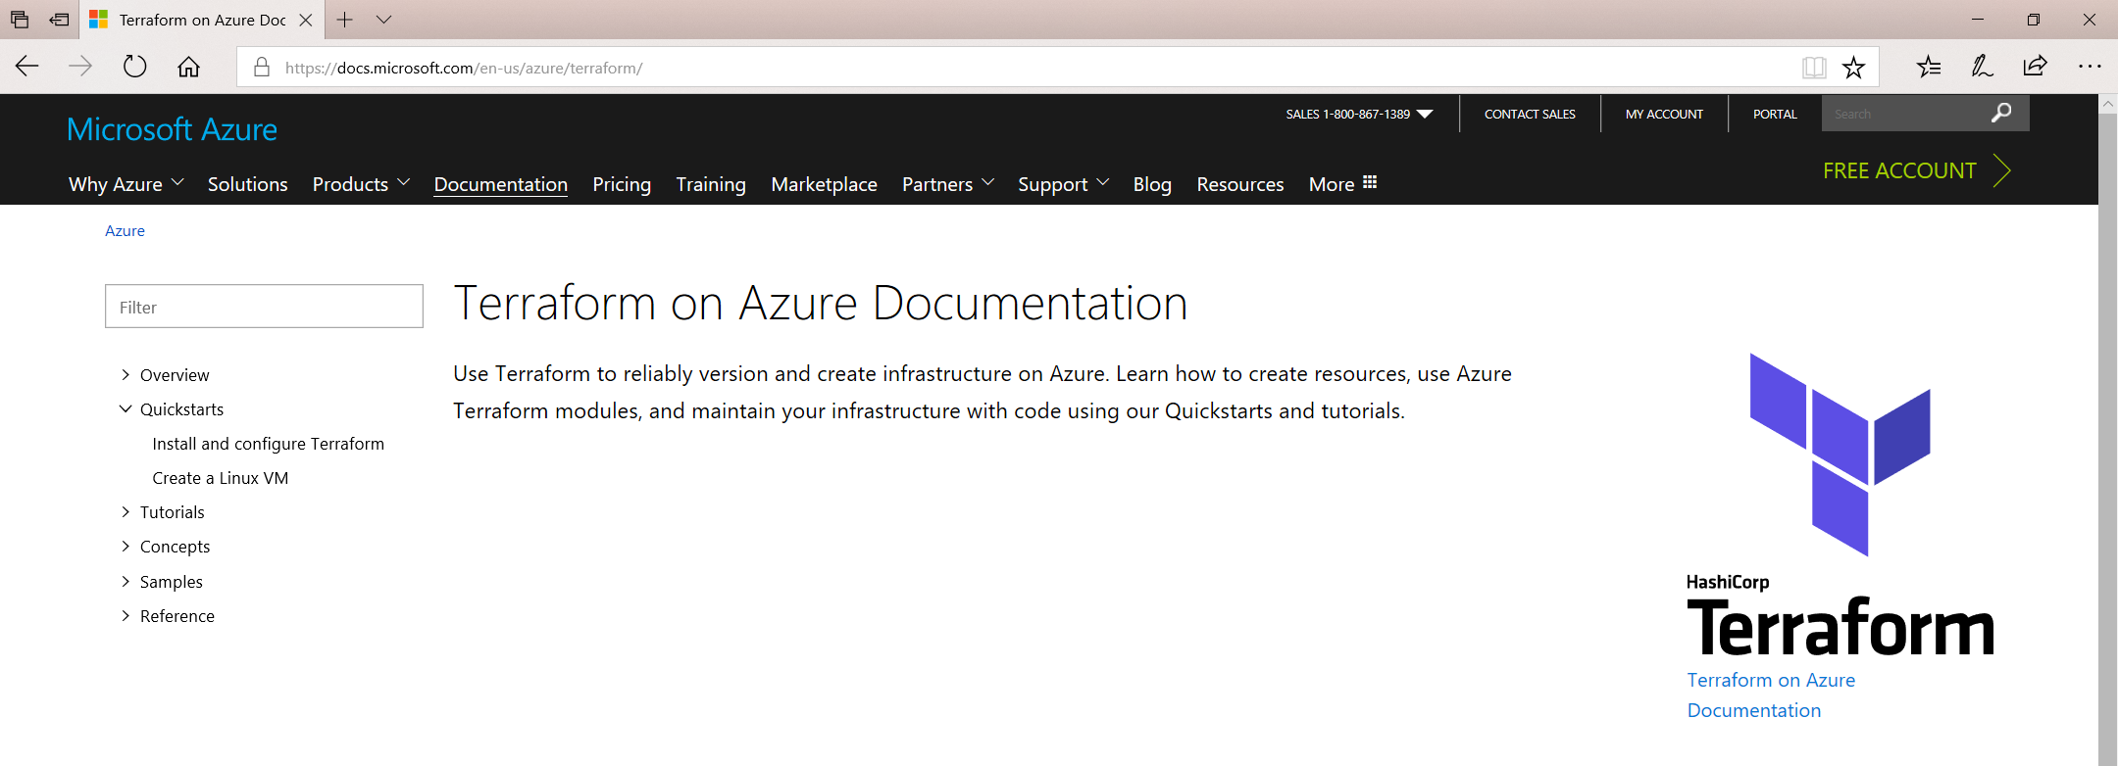
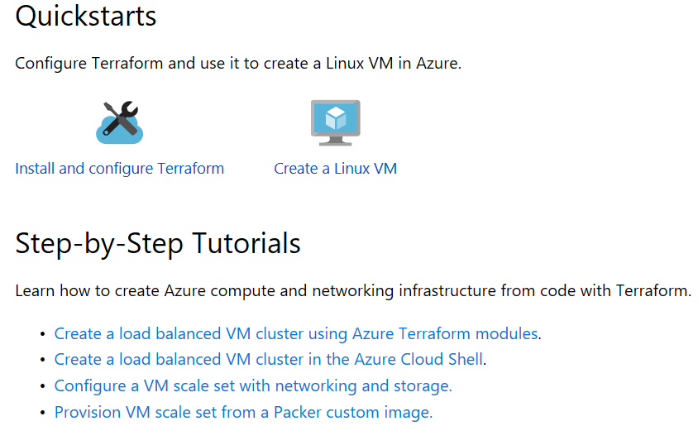


Developer Hub for Terraform
http://aka.ms/tfhub
https://docs.microsoft.com/azure/Terraform/
The best place to find technical guidance for Terraform on Azure
Jenkins and Ansible Developer Hubs also available

Slide 28
Community membership levels (benefits)
Advisor – Azure Terraform User with NDA (Backlog)
Insider – Leadership Quote/Tweet (Prioritize issues)
Influencer – Case Study (CAT/CSE help)
Contributor – Doc/Module contributions (Prioritize features)
Elite – Provider contributions (Product Team help)

Slide 29
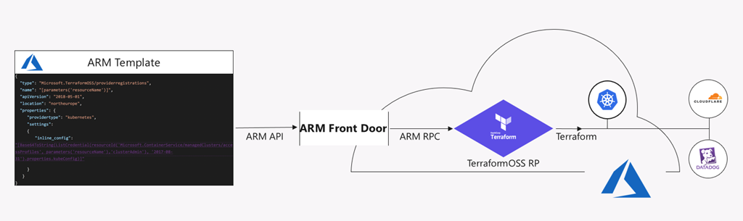
ARM + Terraform
https://azure.microsoft.com/en-us/blog/introducing-the-azure-terraform-resource-provider/

Slide 30
Session resources
Docs – http://aka.ms/terraform
Code – http://aka.ms/tfgit
Articles – http://aka.ms/tfhub
Solution – http://aka.ms/azdotf
Advisors – email me (mark.gray@Microsoft.com)
tweet me (@markg_msft)

Slide 31
Session objectives and takeaways
At the end of this session, you can now …
Understand how Azure fits into your multi-cloud strategy
Be confident that Microsoft is investing deeply in Terraform
Become part of the community making Terraform in Azure better
Key takeaway from this session …
Have the tools / tips needed to take full advantage of Terraform in Azure

Slide 32
Please evaluate this session Your feedback is important to us!
Please evaluate this session through MyEvaluations on the mobile app or website.
Download the app: https://aka.ms/ignite.mobileApp
Go to the website: https://myignite.techcommunity.microsoft.com/evaluations

